Slide 1
CSE 406 Project
ARP DoS via Gratuitous ARP storm
Members:
2005074 – Dipanta Kumar Roy Nobo
2005090 – Tawkir Aziz Rahman

Slide 2

Understanding ARP Gratuitous Storm Attacks and Defence
This presentation will explore the vulnerabilities of the ARP protocol, detail attack methods like gratuitous ARP storms, and outline essential defence strategies to secure local networks. We'll cover the attack's impact and practical mitigation techniques.

Slide 3
What is ARP and Gratuitous ARP?
ARP Protocol
Gratuitous ARP
Stateless Nature
ARP (Address Resolution Protocol) is fundamental for IPv4 networks, mapping IP addresses to physical MAC addresses. This mapping allows devices to locate each other on a local network segment.
A gratuitous ARP is an unsolicited ARP reply, broadcast by a device to announce its IP-to-MAC address mapping. It's used for legitimate purposes like updating ARP caches or detecting IP conflicts.
A key vulnerability of ARP is its stateless nature; devices accept ARP replies and update their caches without verifying if a request was ever made, making them susceptible to malicious updates.

Slide 4




ARP Gratuitous Storm Attack Explained
An ARP gratuitous storm attack involves an attacker flooding the local network with fake, unsolicited ARP replies. These malicious packets contain falsified IP-to-MAC mappings, causing network devices to update their ARP caches incorrectly.
Flooding the Network
Cache Poisoning
The attacker sends a high volume of gratuitous ARP replies, rapidly saturating the network.
Network devices, including switches and hosts, receive these fake replies and overwrite their legitimate ARP cache entries with the attacker's MAC address associated with various IPs.
Traffic Redirection
Denial of Service (DoS)
Consequently, traffic intended for legitimate devices (e.g., the default gateway) is redirected to the attacker's machine, enabling Man-in-the-Middle (MITM) attacks.
The sheer volume of forged ARP traffic can overwhelm network devices and hosts, leading to network disruption and denial of service.

Slide 5
Flooding attack
Exhausted with calculation
Sends Gratuitous ARP
Saying Hi Im 1010
And Im ip 10.0.1.10
MAC - 3030
Sends Gratuitous ARP
Saying Hi Im 1010
And Im ip 10.0.1.10
MAC - 1010
Sends Gratuitous ARP
Saying Hi Im 1010
And Im ip 10.0.1.10
Observer 10.0.1.30
Attacker 10.0.1.10
Sends Gratuitous ARP
Saying Hi Im 1010
And Im ip 10.0.1.10
Sends Gratuitous ARP
Saying Hi Im 1010
And Im ip 10.0.1.10
Sends Gratuitous ARP
Saying Hi Im 1010
And Im ip 10.0.1.10
Sends Gratuitous ARP
Saying Hi Im 1010
And Im ip 10.0.1.10
Sends Gratuitous ARP
Saying 10.0.1.10 is 1010 MAC (Fake)
MAC - 2020
MAC - 0101
Exhausted with calculation
Victim 10.0.1.20
Gateway 10.0.1.1
Exhausted with calculation
IP | MAC
10.0.1.1 | 0101
10.0.1.10
IP | MAC
10.1.0.20 | 2020
Gateway ARP table
Victim ARP table

Slide 6
Man In the middle attack
MAC - 3030
MAC - 1010
Sends Gratuitous ARP
Saying 10.0.1.1 is 1010 MAC (Fake)
Observer 10.0.1.30
Attacker 10.0.1.10
Sends Gratuitous ARP
Saying 10.0.1.20 is 1010 MAC (Fake)
Exhausted with wrong cache entries
MAC - 2020
MAC - 0101
Victim 10.0.1.20
Gateway 10.0.1.1
Exhausted with wrong cache entries
Cant find the right MAC
IP | MAC
10.0.1.1 | 0101
IP | MAC
10.0.1.20 | 2020
Gateway ARP table
Victim ARP table

Slide 7
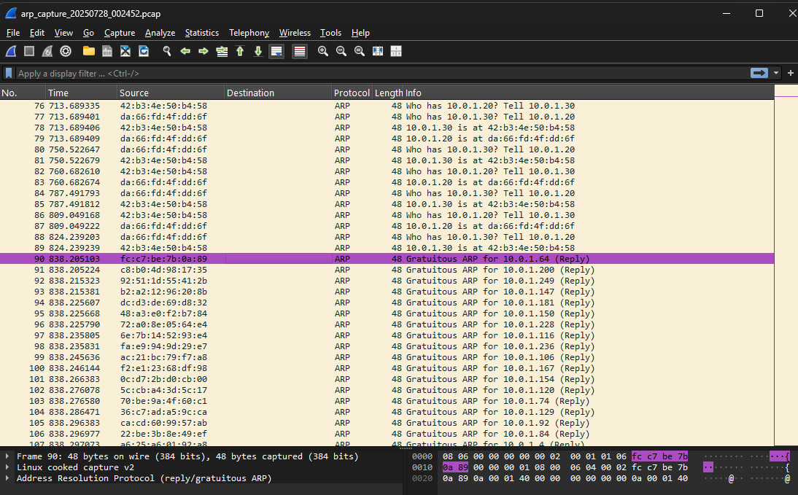

Slide 8
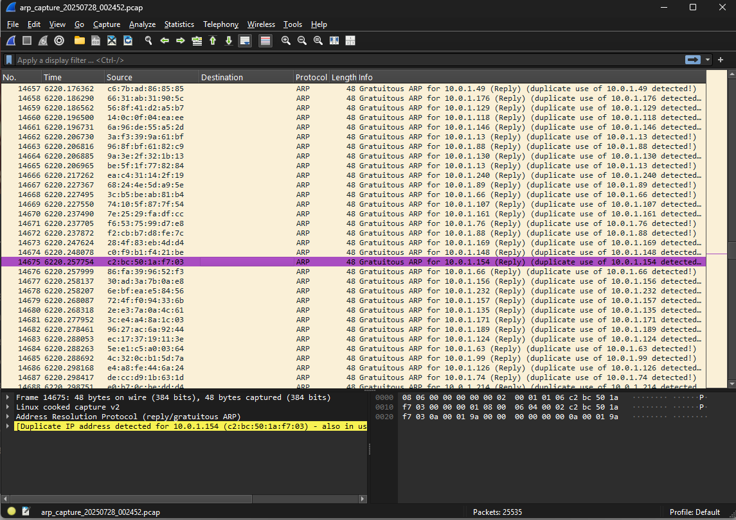

Slide 9

Impact and Risks of ARP Gratuitous Storms
Man-in-the-Middle (MITM) Interception: Attackers can intercept and read sensitive data, including login credentials and confidential communications.
Session Hijacking: Gaining unauthorised control over active user sessions, leading to data breaches or system compromise.
Network Disruption and Performance Degradation: The high volume of fake ARP traffic can congest the network, causing severe performance issues or complete outages.
Facilitation of Further Attacks: ARP storms can be a precursor to more sophisticated attacks, such as Distributed Denial of Service (DDoS) or malware injection.

Slide 10




Detecting ARP Gratuitous Storm Attacks
Detecting an ARP gratuitous storm requires vigilant monitoring and the use of specific tools.
Monitor ARP Tables
Command Line Checks
Regularly inspect ARP tables for unusual entries, such as multiple IP addresses mapped to the same MAC address, indicating suspicious activity.
Use the `arp -a` command on Windows or Linux to view current ARP cache entries and spot any suspicious or rapidly changing mappings.
Network Traffic Analysis
ARP Monitoring Software
Utilise packet sniffers like Wireshark to capture and analyse network traffic. Look for an unusually high volume of ARP replies without corresponding requests.
Deploy dedicated ARP monitoring tools such as cARP or ARPwatch, which are designed to detect and alert on ARP table inconsistencies and anomalies in real-time.

Slide 11
Defence Mechanisms: DHCP Snooping & Dynamic ARP Inspection
DHCP Snooping
Dynamic ARP Inspection (DAI)
DHCP Snooping validates DHCP messages and maintains a database of trusted IP-MAC address bindings. This table is then used to verify the legitimacy of ARP packets.
DAI leverages the trusted bindings from DHCP Snooping to block invalid ARP packets on untrusted switch ports. It ensures that only valid ARP replies are processed.
Builds trusted bindings from legitimate DHCP exchanges.
Drops ARP packets with invalid IP-MAC mappings.
Requires trusted ports for DHCP servers and network devices.
Prevents rogue DHCP servers from assigning fake IPs.
Both DHCP Snooping and DAI are crucial features configured on managed switches to provide robust protection against ARP spoofing and storms.

Slide 12
Software Tools and Network Configurations
Beyond switch-level defences, various software tools and network configurations can enhance protection against ARP attacks.
ARP Spoofing Detection Tools
Arpspoof, Ettercap, Cain & Abel
ARP Monitoring & Alerting
cARP, ARPwatch, Net Sensor
Traffic Encryption
Use VPNs (Virtual Private Networks) to encrypt all network traffic, preventing Man-in-the-Middle (MITM) data interception.
Secure Protocols
Prioritise cryptographic protocols like TLS, SSH, and HTTPS for all sensitive communications.

Slide 13

Best Practices for Prevention
Limit Trust: Avoid relying solely on IP addresses for trust relationships within the network. Implement additional authentication.
Regular Updates: Ensure all network devices, operating systems, and software are regularly updated and patched to address known vulnerabilities.
Network Segmentation: Implement VLANs (Virtual Local Area Networks) to segment the network, isolating different departments or device types. This limits the blast radius of ARP attacks.
User Education: Train users and administrators to recognise the signs of ARP-based attacks, fostering a security-aware culture.

Slide 14
Case Study: Implementing ARP Defence on Enterprise Switches
A medium-sized enterprise deployed Juniper EX Series switches across its network, aiming to mitigate ARP spoofing and flooding incidents.
Port Configuration
Configuration Setup
Ports connected to legitimate DHCP servers and core network infrastructure were configured as "trusted." All client-facing ports were designated as "untrusted."
DHCP Snooping and Dynamic ARP Inspection (DAI) were enabled globally on all access layer switches.
Outcome
Verification
Post-implementation, the organisation observed a significant reduction in reported ARP spoofing incidents and enhanced network stability, demonstrating the effectiveness of integrated defence.
Network administrators used commands like `show ethernet-switching-options analyser` and `show ip-source-binding` to confirm the active status of DHCP Snooping and DAI, verifying the integrity of IP-MAC bindings.

Slide 15
Summary and Key Takeaways
ARP gratuitous storm attacks exploit fundamental weaknesses in the ARP protocol, leading to serious security breaches like MITM and DoS. Effective defence requires a multi-layered approach.
Attack Vulnerability: ARP's stateless nature allows attackers to poison network caches with fake gratuitous ARP replies.
Vigilant Detection: Crucial for early response, involving ARP table monitoring, traffic analysis with tools like Wireshark, and alerts from dedicated ARP monitoring software.
Layered Defence: Combine managed switch features (DAI, DHCP Snooping), host-based tools (static ARP, firewall rules), and traffic encryption (VPNs, HTTPS/TLS).
Proactive Security: Network segmentation (VLANs), regular updates, and continuous user education are vital for a robust defence posture against evolving ARP-based threats.

Slide 16
Thank you

